Slide 1
Part 1:
Java as an Object-oriented Programming Language
05. Polymorphism

Slide 2
Polymorphism

Slide 3
Motivation
Given the following:
  Lawyer laura = new Lawyer();
  Marketer mark = new Marketer();
Write a program that will print out the salaries and the color of the vacation form for each employee.

Slide 4
Polymorphism
A reference variable of type T can refer to an object of any subclass of T.
  Employee person = new Lawyer();
polymorphism: The ability for the same code to be used with several different types of objects and behave differently depending on the type of object used.

Slide 5
Dynamic (or Run-Time) Type and
Static (or Compile-Time) Type
  Employee person = new Lawyer();
The variable person has two types:
  static type: Employee
    This is the type that the compiler uses to determine if statements are legal Java statements.
    Therefore, any method called with the person variable must be declared in the Employee class (or else the compiler will complain).
  dynamic type: Lawyer
    This is the type that the Java virtual machine uses to execute code when the program is run.
    Any method called with the person variable will execute the version of that method defined in the Lawyer class.

Slide 6
Properties of polymorphism
Employee person = new Lawyer();
System.out.println(person.getSalary()); // 40000.0
System.out.println(person.getVacationForm()); // "pink"
You can call any method from Employee on the person variable, but not any method specific to Lawyer (such as sue).
Once a method is called on the object, it behaves in its normal way (as a Lawyer, not as a normal Employee).

Slide 7
Polymorphism and parameters
public class EmployeeMain {
public static void main(String[] args) {
Lawyer laura = new Lawyer();
Marketer mark = new Marketer();
printInfo(laura);
printInfo(mark);
}
public static void printInfo(Employee empl) {
System.out.println("salary = " + empl.getSalary());
System.out.println("days = " + empl.getVacationDays());
System.out.println("form = " + empl.getVacationForm());
System.out.println();
}
}
Output:
salary = 40000.0
vacation days = 15
vacation form = pink
salary = 50000.0
vacation days = 10
vacation form = yellow

Slide 8
Polymorphism and arrays
public class EmployeeMain2 {
public static void main(String[] args) {
Employee[] employees = { new Lawyer(), new Secretary(),
new Marketer(), new LegalSecretary() };
for (int i = 0; i < employees.length; i++) {
System.out.println("salary = " + employees[i].getSalary());
System.out.println("vacation days = " +
employees[i].getVacationDays());
System.out.println();
}
}
}
Output:
salary = 40000.0
vacation days = 15
salary = 40000.0
vacation days = 10
salary = 50000.0
vacation days = 10
salary = 45000.0
vacation days = 10

Slide 9
Variable Shadowing:
Something to avoid!!
Polymorphism applies to methods in Java
But not to fields!
public class A {
int x = 1;
int method() { return 1; }
}
public class B extends A {
int x = 2;
int method() { return 2; }
}
A a1 = new A();
A a2 = new B();
System.out.println(a1.method()); // prints 1
System.out.println(a2.method()); // prints 2
System.out.println(a1.x);
// prints 1
System.out.println(a2.x);
// prints 1 still!

Slide 10
Variable Shadowing:
Something to avoid!!
Variable Shadowing:
  When a class extends another class and defines a field with the same name, each object of the subclass contains two fields with that name.
  The subclass’s version of the field is said to shadow the superclass’s version, making the superclass’s version invisible within that class.
  This is called variable shadowing.

Slide 11
Variable Shadowing:
Something to avoid!!
Variable Shadowing and References
If class B extends class A and both have a field of the same name, references to objects of type B can access one or the other of the fields.
The version of the field that they reference depends on the type of the reference variable.

Slide 12
Variable Shadowing:
Something to avoid!!
public class A {
int x = 1;
int method() { return 1; }
}
public class B extends A {
int x = 2;
int method() { return 2; }
}
A a1 = new A();
A a2 = new B();
System.out.println(a1.method()); // prints 1
System.out.println(a2.method()); // prints 2
System.out.println(a1.x);
// prints 1
System.out.println(a2.x);
// prints 1 still!
// because reference a2 has
// compile-time type A.

Slide 13
Variable Shadowing:
Something to avoid!!
public class A {
int x = 1;
int method() { return 1; }
}
public class B extends A {
int x = 2;
int method() { return 2; }
}
A a1 = new A();
A a2 = new B();
B b1 = (B)a2;
System.out.println(a1.method()); // prints 1
System.out.println(a2.method()); // prints 2
System.out.println(a1.x);
// prints 1
System.out.println(a2.x);
// prints 1 still!
System.out.println(b1.x);
// prints 2!
// because b1 has static type B

Slide 14
Overriding vs. Variable Shadowing
Overriding | Variable Shadowing
Applies to methods | Applies to fields
If subclass overrides a superclass method, it does not inherit the superclass method. | If a subclass shadows a superclass field, it does inherit the superclass field, but shadows it.
The behavior of a method call depends on the dynamic (run-time) type of the object. | The behavior of a field access depends on the static (compile-time) type of the reference to the object.

Slide 15
Variable Shadowing:
Something to avoid!!
By this time, hopefully you can see that variable shadowing on its own is not that all that complicated, no more than method overriding.
But if you have to keep track of both method overriding and variable shadowing, then variable shadowing is very confusing
In general, programmers try to avoid it, and they use method overriding all the time.

Slide 16
Relationships among Classes
Association
Aggregation
Composition
Inheritance

Slide 17
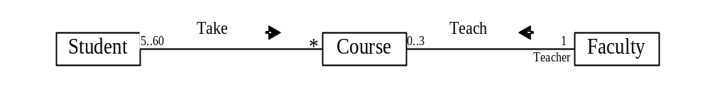
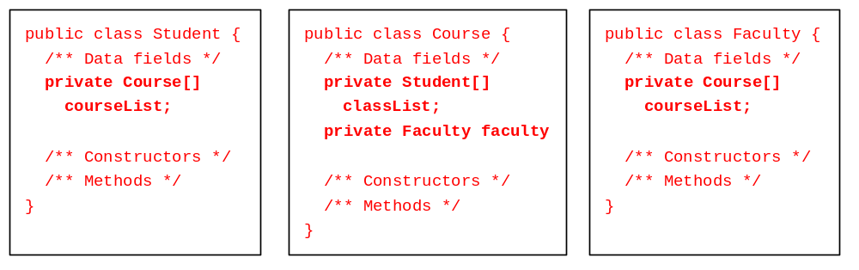
Association
Association represents a general binary relationship that describes an activity between two classes.
An association is usually represented as a data field in the class.

Slide 18
Translation is not Unique
NOTE: If you don’t need to know the courses a student takes or a faculty teaches, the data field coureList in Student or Faculty can be omitted.

Slide 19

Association Between Same Class
Association may exist between objects of the same class. For example, a person may have a supervisor.

Slide 20
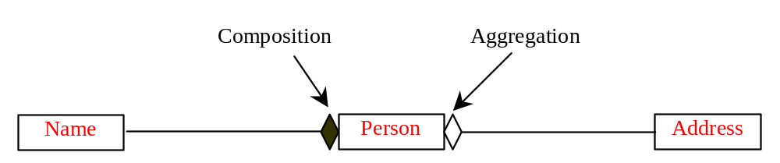
Aggregation and Composition
Aggregation is a special form of association, which represents an ownership relationship between two classes. Aggregation models the has-a relationship.
If an object is exclusively owned by an aggregated object, the relationship between the object and its aggregated object is referred to as composition.

Slide 21
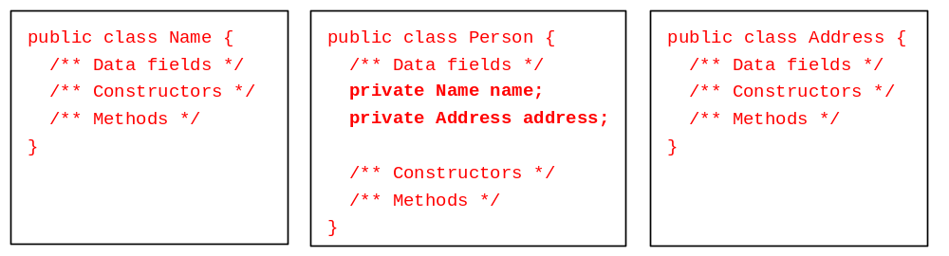
Representing Aggregation in Classes
An aggregation relationship is usually represented as a data field in the aggregated class.

Slide 22
Inner Classes Translation
If Name or Address is used in the Person class only, they can be declared as an inner class in Person. For example,
public class Person {
private Name name;
private Address address;
...
class Name {
...
}
class Address {
...
}
}

Slide 23
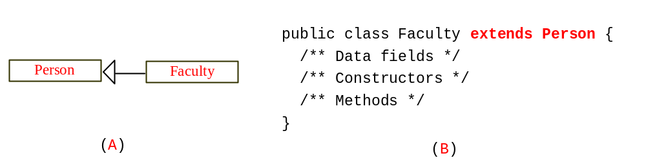
Inheritance
Inheritance models the is-an-extension-of relationship between two classes.

Slide 24
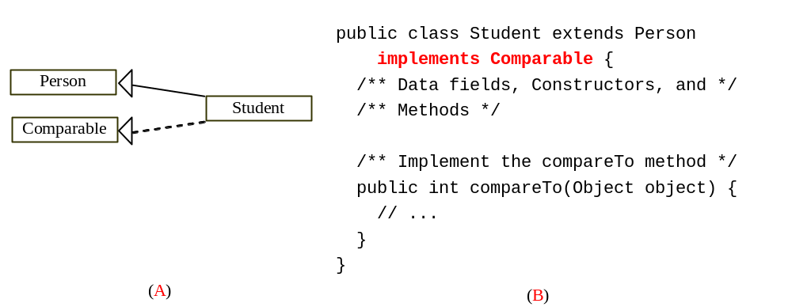
Weak Inheritance Relationship
A weak is-an-extension-of relationship can be represented using interfaces. For example, the weak is-an-extension-of relationship “students are comparable based on their grades” can be represented by implementing the Comparable interface, as follows:

